Slide 1
Rockbuster Stealth data analysis

Slide 2

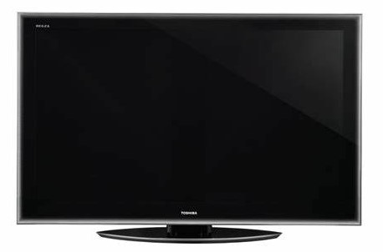
introduction
Rockbuster stealth is a movie rental company that used to have stores around the world. Facing stiff competition from streaming services such as Netflix and amazon prime, the Rockbuster stealth management team is planning to use its extensive movie licenses to launch an online video rental service in order to stay competitive.
LUXURY CINEMA THEATER
This template contains an assortment of complementary infographic resources for the Luxury Cinema Theater Pitch Deck presentation.
These infographics are adapted to the style of the before mentioned presentation, so you can insert them easily and have the completely integrated at once. You just need to do the following:
Select the element that you want to copy
Right-click and choose “Copy”
Go to the slide where you want the element to appear
Right-click and choose “Paste”

Slide 3
Key question 1
What was the average rental duration for all videos?

Slide 4
What was the average rental duration for all videos?
Rental Duration
Minimum:
3 days
Average:
5 days
Maximum:
7 days

Slide 5
Analysis
The average rental duration is exactly 4.985 days, but we rounded it to approximately 5 days.
LUXURY CINEMA THEATER
This template contains an assortment of complementary infographic resources for the Luxury Cinema Theater Pitch Deck presentation.
These infographics are adapted to the style of the before mentioned presentation, so you can insert them easily and have the completely integrated at once. You just need to do the following:
Select the element that you want to copy
Right-click and choose “Copy”
Go to the slide where you want the element to appear
Right-click and choose “Paste”

Slide 6
Key question 2
Which movies contributed the most and least to revenue gain?

Slide 7
Which movies contributed the most and least to revenue gain?
Top 10 Sellers
Bottom 10 Sellers
Title | Revenue Gain
Telegraph Voyage | $215.75
Zorro Ark | $199.72
Wife Turn | $198.73
Innocent Usual | $191.74
Hustler Party | $190.78
Saturday Lambs | $190.74
Titans Jerk | $186.73
Harry Idaho | $177.73
Torque Bound | $169.76
Dogma Family | $168.72
Title | Revenue Gain
Texas Watch | $5.94
Oklahoma Jumanji | $5.94
Duffel Apocalypse | $5.94
Freedom Cleopatra | $5.95
Young Language | $6.93
Rebel Airport | $6.93
Cruelty Unforgiven | $6.94
Treatment Jekyll | $6.94
Lights Deer | $7.93
Stallion Sundance | $7.94

Slide 8
Rockbuster Stealth movie rental statistics
Rental Rate
Minimum:
$0.99
Average:
$2.98
Maximum:
$4.99

Slide 9
Analysis
The average rental is approximately $3.00. For the top grossing movie of about $215.75, we can say that was rented around 72 times.
For the least popular movies, at $5.94, they were rented about two times.
This represents our range.
LUXURY CINEMA THEATER
This template contains an assortment of complementary infographic resources for the Luxury Cinema Theater Pitch Deck presentation.
These infographics are adapted to the style of the before mentioned presentation, so you can insert them easily and have the completely integrated at once. You just need to do the following:
Select the element that you want to copy
Right-click and choose “Copy”
Go to the slide where you want the element to appear
Right-click and choose “Paste”

Slide 10
Key question 3
Which countries are Rockbuster customers based in?

Slide 11
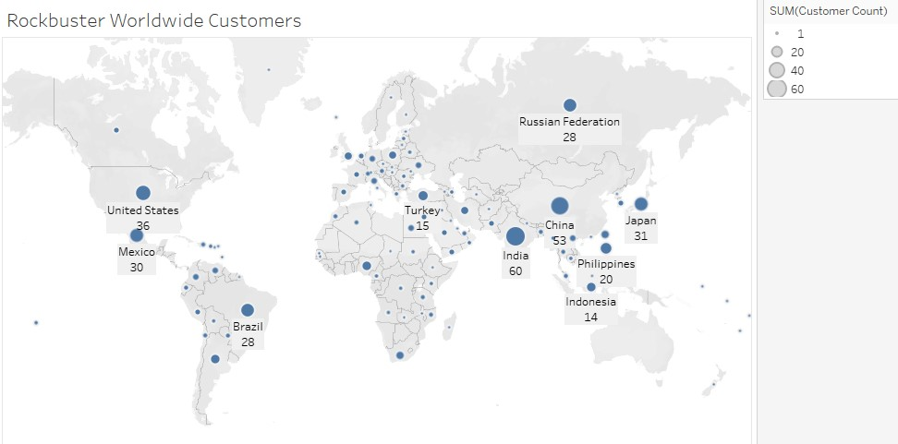
Which countries are Rockbuster customers based in?
Top 10 Countries
Country | Total Number of Customers
India | 60
China | 53
United States | 36
Japan | 31
Mexico | 30
Brazil | 28
Russian Federation | 28
Philippines | 20
Turkey | 15
Indonesia | 14

Slide 12
Analysis
The Countries with the most Rockbuster customers are india, China, and the united states.
There does not appear to be a cluster of Rockbuster countries. They are spread out all over the world.
LUXURY CINEMA THEATER
This template contains an assortment of complementary infographic resources for the Luxury Cinema Theater Pitch Deck presentation.
These infographics are adapted to the style of the before mentioned presentation, so you can insert them easily and have the completely integrated at once. You just need to do the following:
Select the element that you want to copy
Right-click and choose “Copy”
Go to the slide where you want the element to appear
Right-click and choose “Paste”

Slide 13
Key question 4
Where are customers with a high lifetime value based?

Slide 14
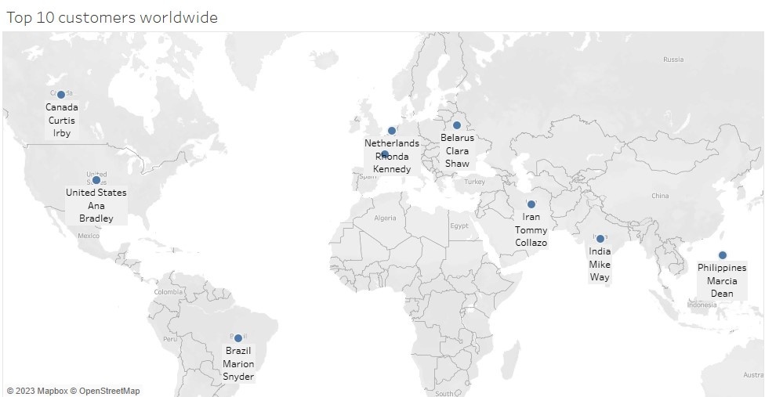
Where are customers with a high lifetime value based?
Top 10 Customers worldwide
First Name | Last Name | Country | City | Total amount paid
Eleanor | Hunt | France | Saint-Denis | $211.55
Karl | Seal | United States | Cape Coral | $208.58
Marion | Snyder | Brazil | Santa Brbara dOeste | $194.61
Rhonda | Kennedy | Netherlands | Apeldoorn | $191.62
Clara | Shaw | Belarus | Molodetno | $189.60
Tommy | Collazo | Iran | Qomsheh | $183.63
Ana | Bradley | United States | Memphis | $167.67
Curtis | Irby | Canada | Richmond Hill | $167.62
Marcia | Dean | Philippines | Tanza | $166.61
Mike | Way | India | Valparai | $162.67

Slide 15
Analysis
The top 10 customers do not come from the top 10 countries.
india, China, usa, Japan and Mexico have the most customers, But the best customers come from France, usA, brazil, Netherlands, and Belarus.
There is very little overlap between top 10 countries and top 10 customers.
LUXURY CINEMA THEATER
This template contains an assortment of complementary infographic resources for the Luxury Cinema Theater Pitch Deck presentation.
These infographics are adapted to the style of the before mentioned presentation, so you can insert them easily and have the completely integrated at once. You just need to do the following:
Select the element that you want to copy
Right-click and choose “Copy”
Go to the slide where you want the element to appear
Right-click and choose “Paste”

Slide 16
Key question 5
Do sales figures vary between geographic locations?

Slide 17
Do sales figures vary between Geographic locations?
Top 10 Customers worldwide
Top 10 Countries
Customer ID | First Name | Last Name | Country | City | Total amount paid
148 | Eleanor | Hunt | Runion | Saint-Denis | $211.55
526 | Karl | Seal | United States | Cape Coral | $208.58
178 | Marion | Snyder | Brazil | Santa Brbara dOeste | $194.61
137 | Rhonda | Kennedy | Netherlands | Apeldoorn | $191.62
144 | Clara | Shaw | Belarus | Molodetno | $189.60
459 | Tommy | Collazo | Iran | Qomsheh | $183.63
181 | Ana | Bradley | United States | Memphis | $167.67
410 | Curtis | Irby | Canada | Richmond Hill | $167.62
236 | Marcia | Dean | Philippines | Tanza | $166.61
403 | Mike | Way | India | Valparai | $162.67
Country | Total Number of Customers
India | 60
China | 53
United States | 36
Japan | 31
Mexico | 30
Brazil | 28
Russian Federation | 28
Philippines | 20
Turkey | 15
Indonesia | 14

Slide 18
Do sales figures vary between Geographic locations?
Top 10 Countries
Country | Total Number of Customers
India | 60
China | 53
United States | 36
Japan | 31
Mexico | 30
Brazil | 28
Russian Federation | 28
Philippines | 20
Turkey | 15
Indonesia | 14

Slide 19
Analysis
There doesn’t appear to be a region that has a high concentration of Rockbuster customers. They are spread out all over the world.
LUXURY CINEMA THEATER
This template contains an assortment of complementary infographic resources for the Luxury Cinema Theater Pitch Deck presentation.
These infographics are adapted to the style of the before mentioned presentation, so you can insert them easily and have the completely integrated at once. You just need to do the following:
Select the element that you want to copy
Right-click and choose “Copy”
Go to the slide where you want the element to appear
Right-click and choose “Paste”

Slide 20
Summary
The average rental was approximately 5 days.
The range of movie rentals were between 2 – 72.
The top 10 revenue countries didn’t have the top 10 customers.
LUXURY CINEMA THEATER
This template contains an assortment of complementary infographic resources for the Luxury Cinema Theater Pitch Deck presentation.
These infographics are adapted to the style of the before mentioned presentation, so you can insert them easily and have the completely integrated at once. You just need to do the following:
Select the element that you want to copy
Right-click and choose “Copy”
Go to the slide where you want the element to appear
Right-click and choose “Paste”

Slide 21
next steps
The data did not show us an obvious place to start the new streaming service.
More data needs to be collected to decide which part of the world would be the best place to start.
Research your competition to see where they started.
Build off the previous success to set yourself apart from your competition.
LUXURY CINEMA THEATER
This template contains an assortment of complementary infographic resources for the Luxury Cinema Theater Pitch Deck presentation.
These infographics are adapted to the style of the before mentioned presentation, so you can insert them easily and have the completely integrated at once. You just need to do the following:
Select the element that you want to copy
Right-click and choose “Copy”
Go to the slide where you want the element to appear
Right-click and choose “Paste”

Slide 22
Thank you!
Presented by: Rich Seiler RichSeiler77@gmail.com
Tableau Visualization Link

